Slide 1
Data Cleaning and Summary Statistics module 5
Note to other teachers and users of these slides. Feel free to use or modify these slides as you wish. If you use a significant portion of these slides in your own lecture, please include this message, or the following link to the source repository of Michele’s lectures on github:
https://github.com/samorani. Comments and corrections are welcome.

Slide 2
Data cleaning
Definition: prepares the data for analysis
One of the most time-consuming tasks in data science

Slide 3
Today’s data set
Let’s consider the survey taken by students at the beginning of the term
data science survey.csv

Slide 4
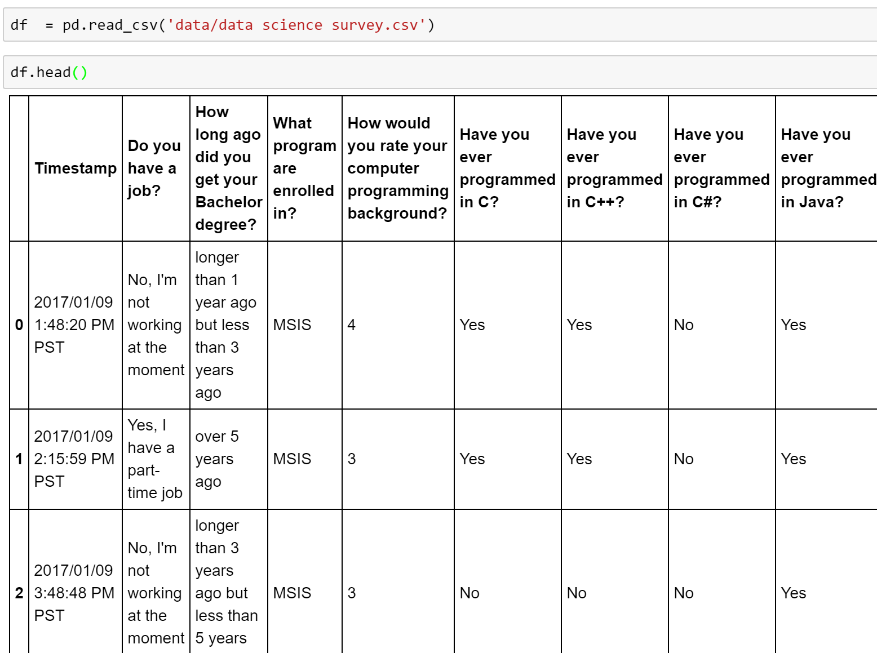
What don’t we like of this table?
Columnn headers are too long
Some cell values are too long
Some cell values are yes/no, but we prefer 1/0

Slide 5
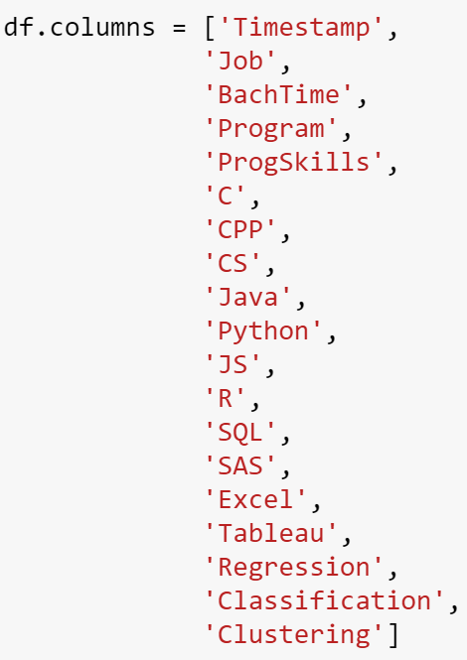
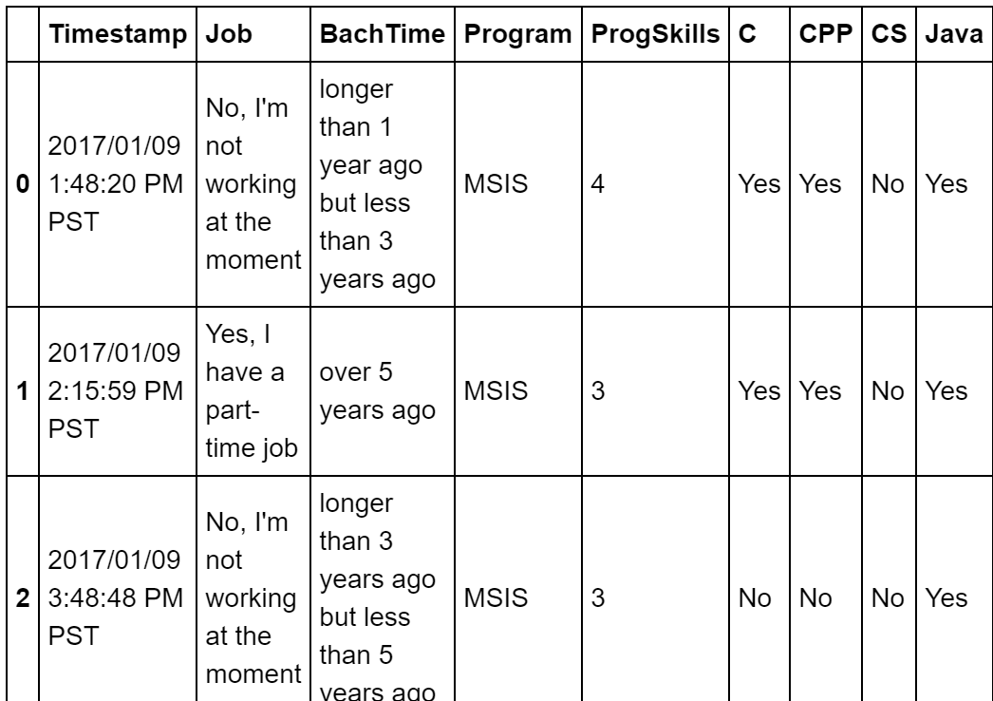
Change the column names

Slide 6
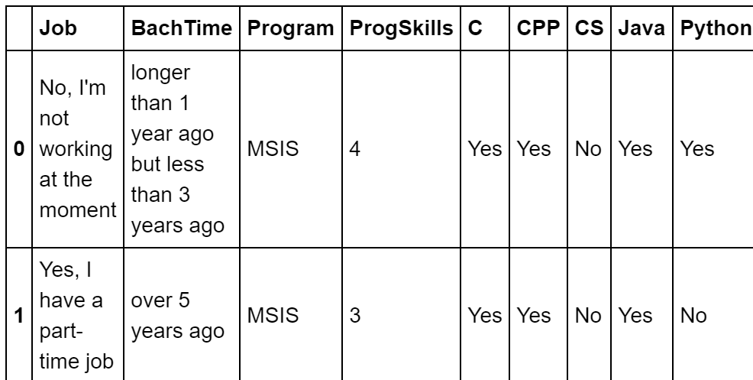
Remove column “Timestamp”
Make the change on df
(instead of returning a
modified copy of df)
Remove a column

Slide 7
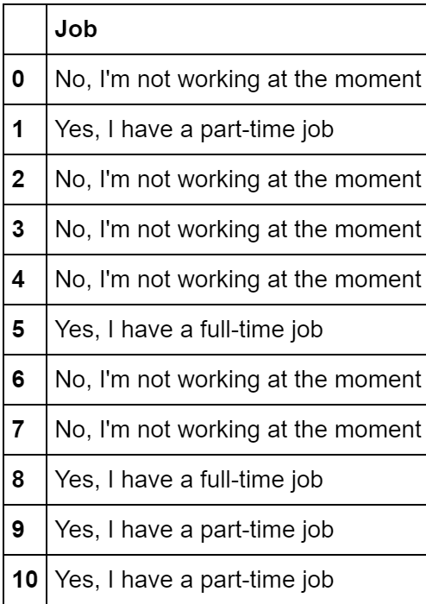
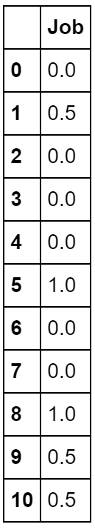
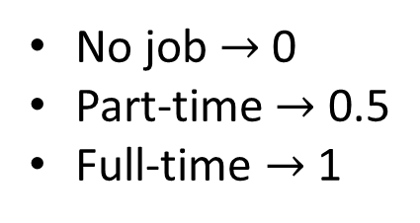
Change values in column “Job”
We want to perform this transformation:
No job $→$ 0
Part-time $→$ 0.5
Full-time $→$ 1

Slide 8
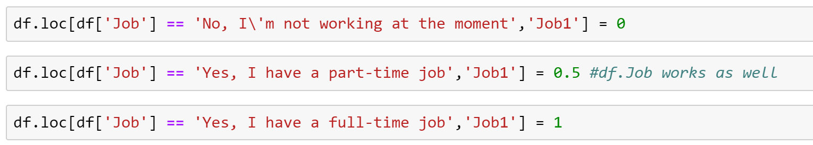
Change values in column “Job”: solution 1
Pros:
Easy
Cons:
Sometimes such solution cannot be used; example: if the new value of the column is retrieved through a complex calculation (e.g., simulation)

Slide 9
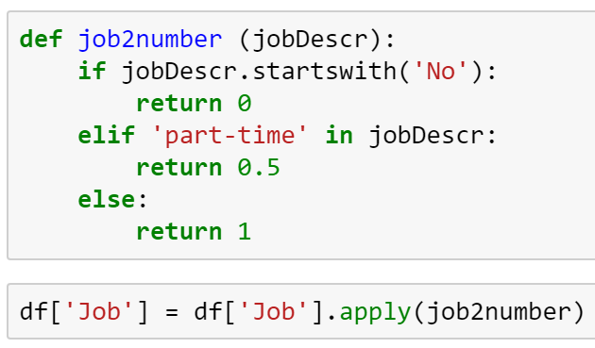
Change values in column “Job”: solution 2
Define the transformation by writing a function whose input is the old value of the column and whose output is the new value of the column. Then, use the DataFrame function “apply”
A function with:
Input = old value
Output = new value
Pros:
Flexible
Cons:
Writing a function takes space and time
Apply this function to df[‘Job’]

Slide 10
Change values in column “Job”: solution 3 (optional)
Instead of declaring a function, use lambda (or anonymous) functions
The keyword lambda defines a short function without the need to give it a name. The function takes $x$ as input and gives a number 0, 0.5, or 1 as output
Pros:
Flexible
Cons:
Can only write one-line functions

Slide 11
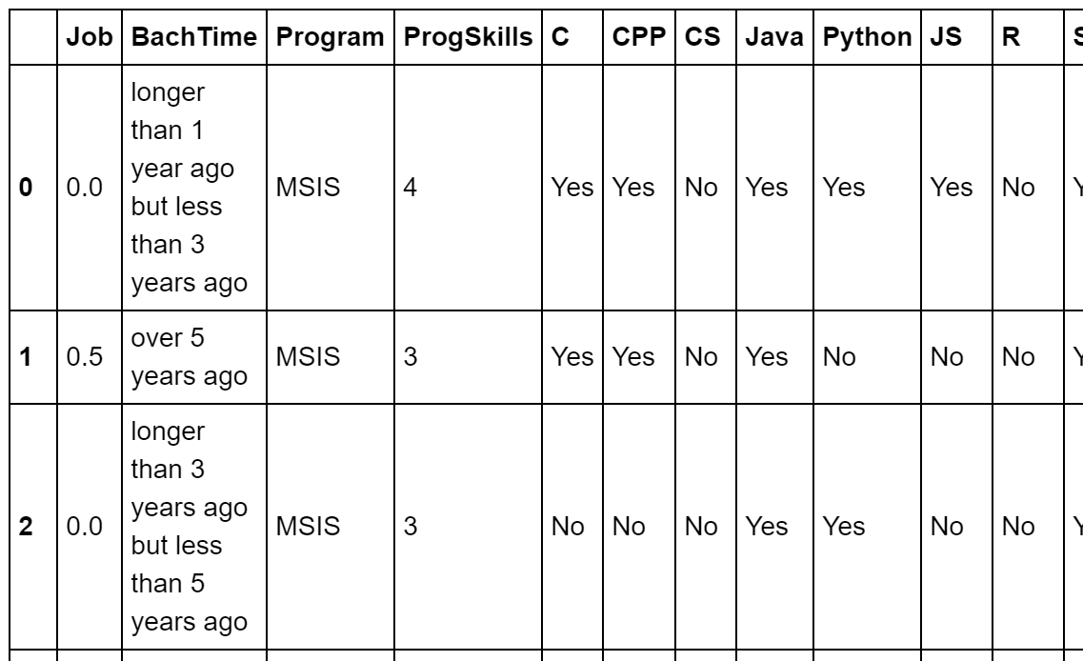
Change values in column “Job”: Result

Slide 12
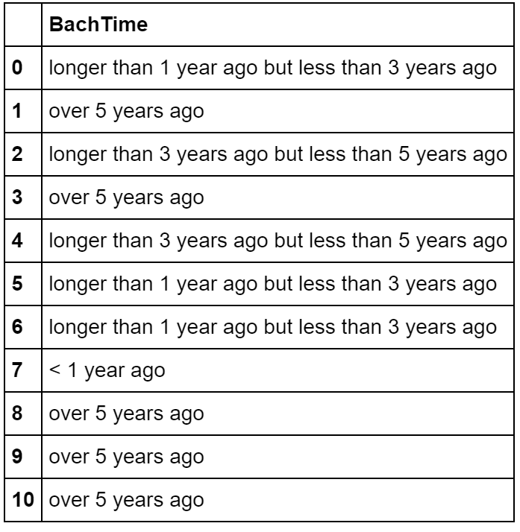
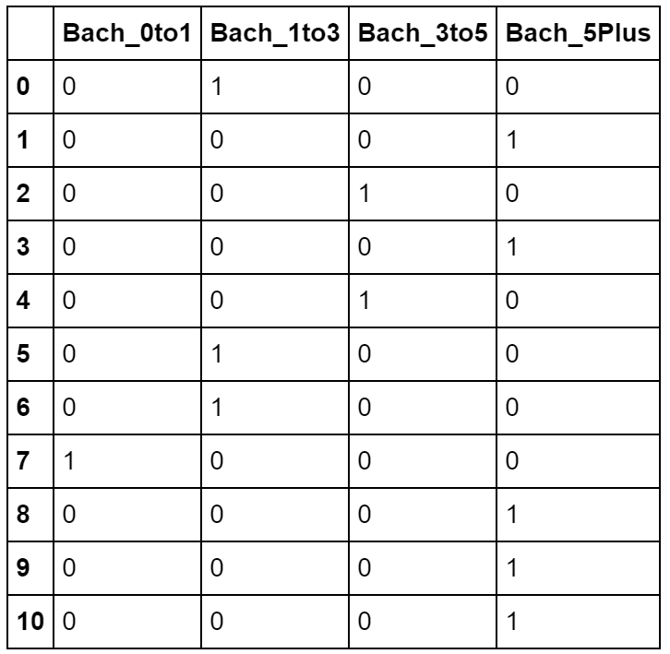
Make BachTime a dummy variable
We want to perform this transformation:

Slide 13
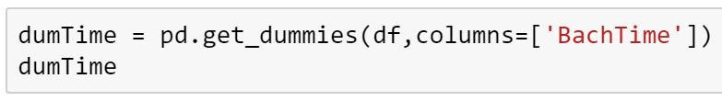
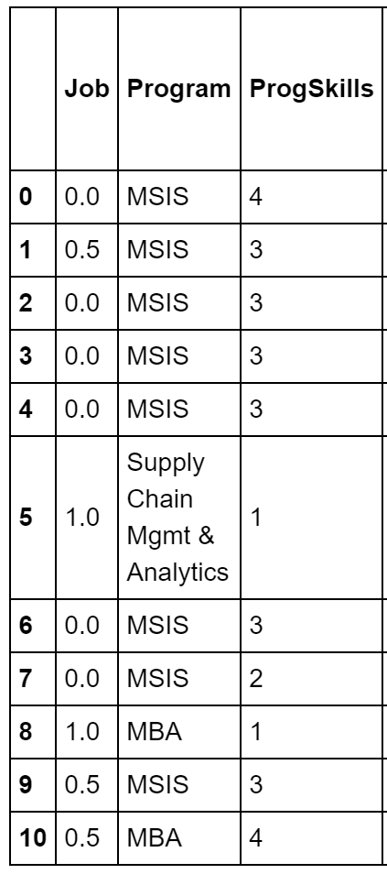
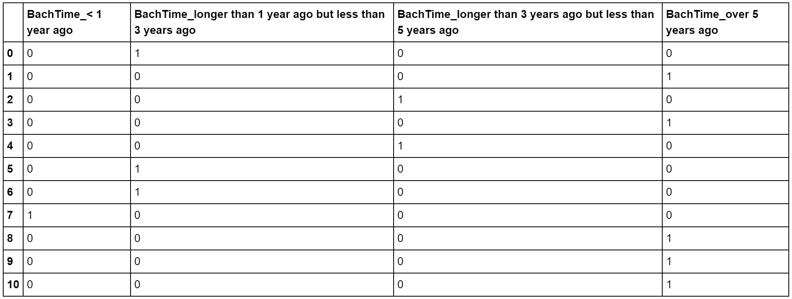
Step 1: use get_dummies
Create a modified copy of the dataframe df where the column BachTime is replaced by dummy columns
…
…
…
…

Slide 14
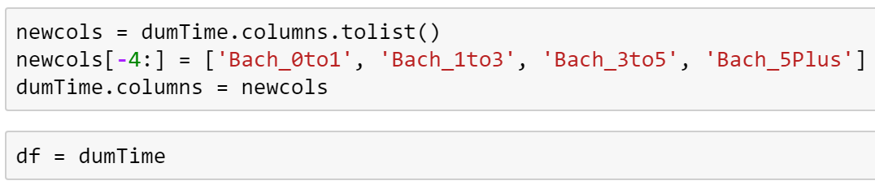
Step 2: change the column names
Note that we cannot modify a column individually: that is, df.columns[0] = ‘newname’ will give an error. However, we can replace the whole set of columns.
Instead, we:
Create a list newcols with the original column names
Modify the last four elements with the new names
Replace the whole set of columns.

Slide 15
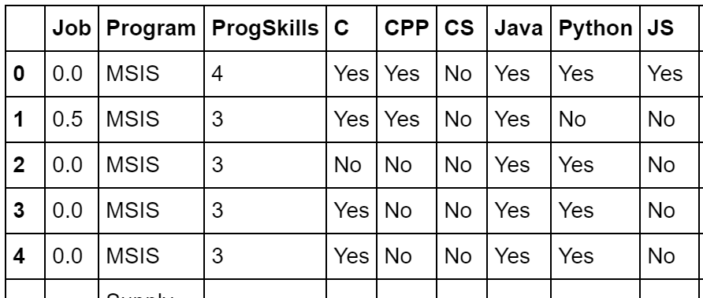
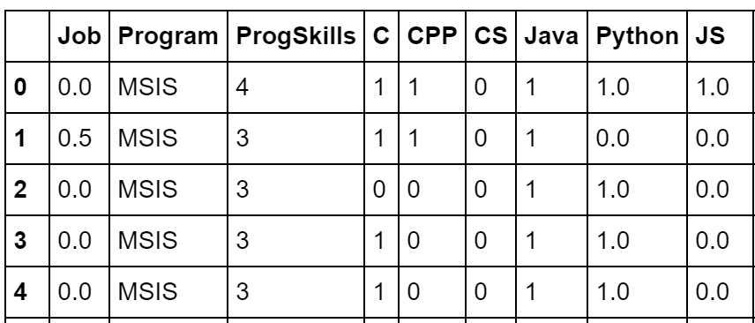
Change “Yes” and “No” to 1 and 0

Slide 16

Change “Yes” and “No” to 1 and 0: Replace
Inplace = True makes the change on df rather than creating a copy
Change the value of all cells equal to “Yes” to 1

Slide 17
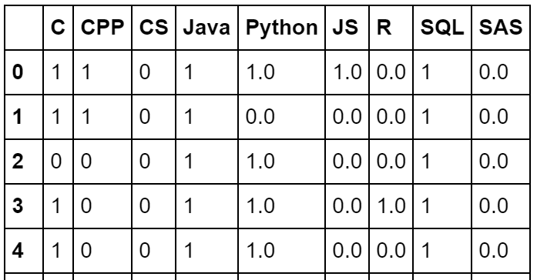
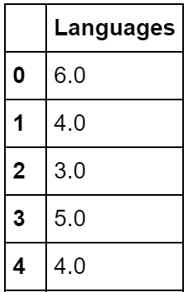
Add a calculated column
Let’s add a column Languages that counts the programming languages known by each student:
Languages = C+CPP+CS+Java+Python+JS+R+SQL+SAS

Slide 18
Add a calculated column
Create a column by simply declaring it

Slide 19
Add a more complex column
Let’s add a column Expert, which is 1 if the student knows at least 3 languages and 0 otherwise.
One possible way is to use the function DataFrame.apply
The function passed has:
Input = one row of the DataFrame
Output = the value of the new column Expert for that row

Slide 20
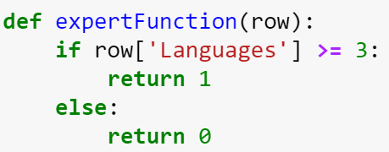

Solution with apply 1/2: define a function
Axis=1 indicates that the function takes a row as input (summarizes columns)

Slide 21
Solution with apply 2/2: lambda function

Slide 22

Performance of DataFrame.apply
It is slow!!
If called with axis=1, it is basically a for-loop through the rows
Do not use it unless it is absolutely needed
Example: for each row, we need to run a simulation
If possible, use operations among Series and scalars

Slide 23
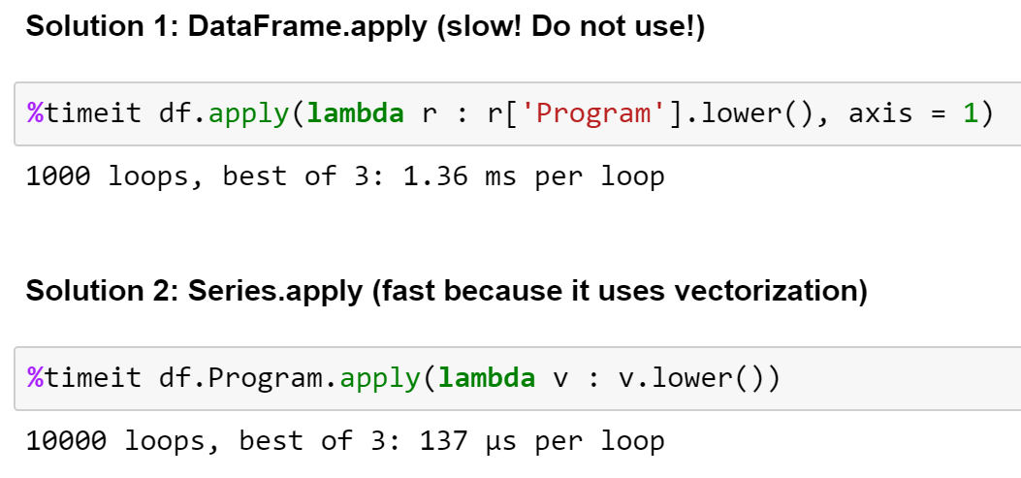
DataFrame.apply vs Series.apply¶
As of pandas 0.20, DataFrame.apply is slow whereas Series.apply is fast.
Example: compute the lower case value of the column Program.
Apply to all rows of the dataframe
Apply to all values of the series

Slide 24
Problems
How many students know SQL?
What's the average programming skills of MSIS students? Compare it to that of MBA students
How many students know classification better than clustering? And how many clustering better than classification?

Slide 25
Summary statistics

Slide 26
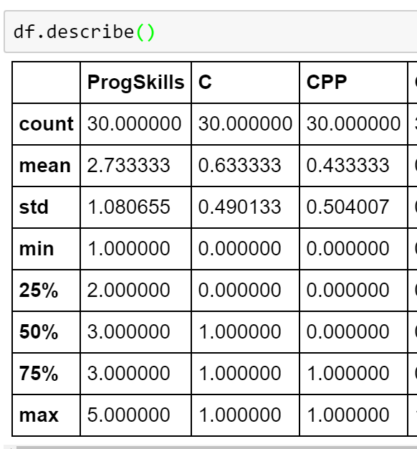
describe
The method describe returns summary statistics for each column
How many not null
percentiles

Slide 27
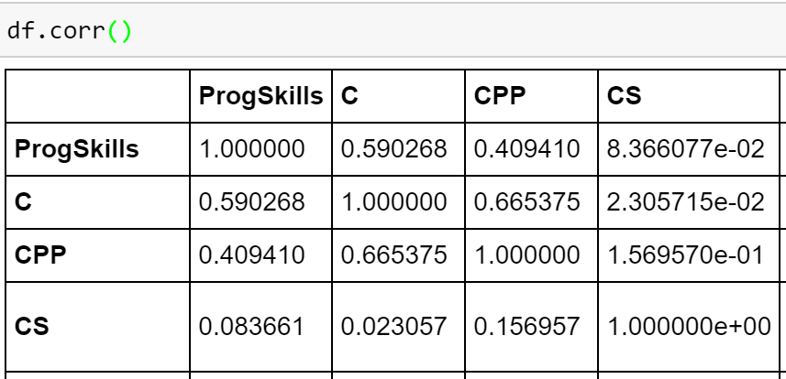
corr
Finds the correlation for each pair of columns
Looks like C and C++ are correlated

Slide 28

Problem to solve together
What are the top 10 correlations and the top 10 anti-correlations? Hint: understand what this does first:

